Slide 1
6+++++
The State of Our Children’s Health
Missouri Coordinated School Health Conference - 2/21/24
Heidi B. Miller, MD
Chief Medical Officer
MO Department of Health & Senior Services
Notes:
30 min

Slide 2
6+++++
Agenda
Tribute to You
We are a Team
State of our Children’s Health
Mortality
Risky Behaviors, Safety, Violence
Chronic Conditions - Mental Health
Social Determinants of Health
Looking Forward
MRO

Slide 3
6+++++
Agenda
Tribute to You
We are a Team
State of our Children’s Health
Mortality
Risky Behaviors, Safety, Violence
Chronic Conditions - Mental Health
Social Determinants of Health
Looking Forward

Slide 4
Thank you for everything you do for our children.

Slide 5
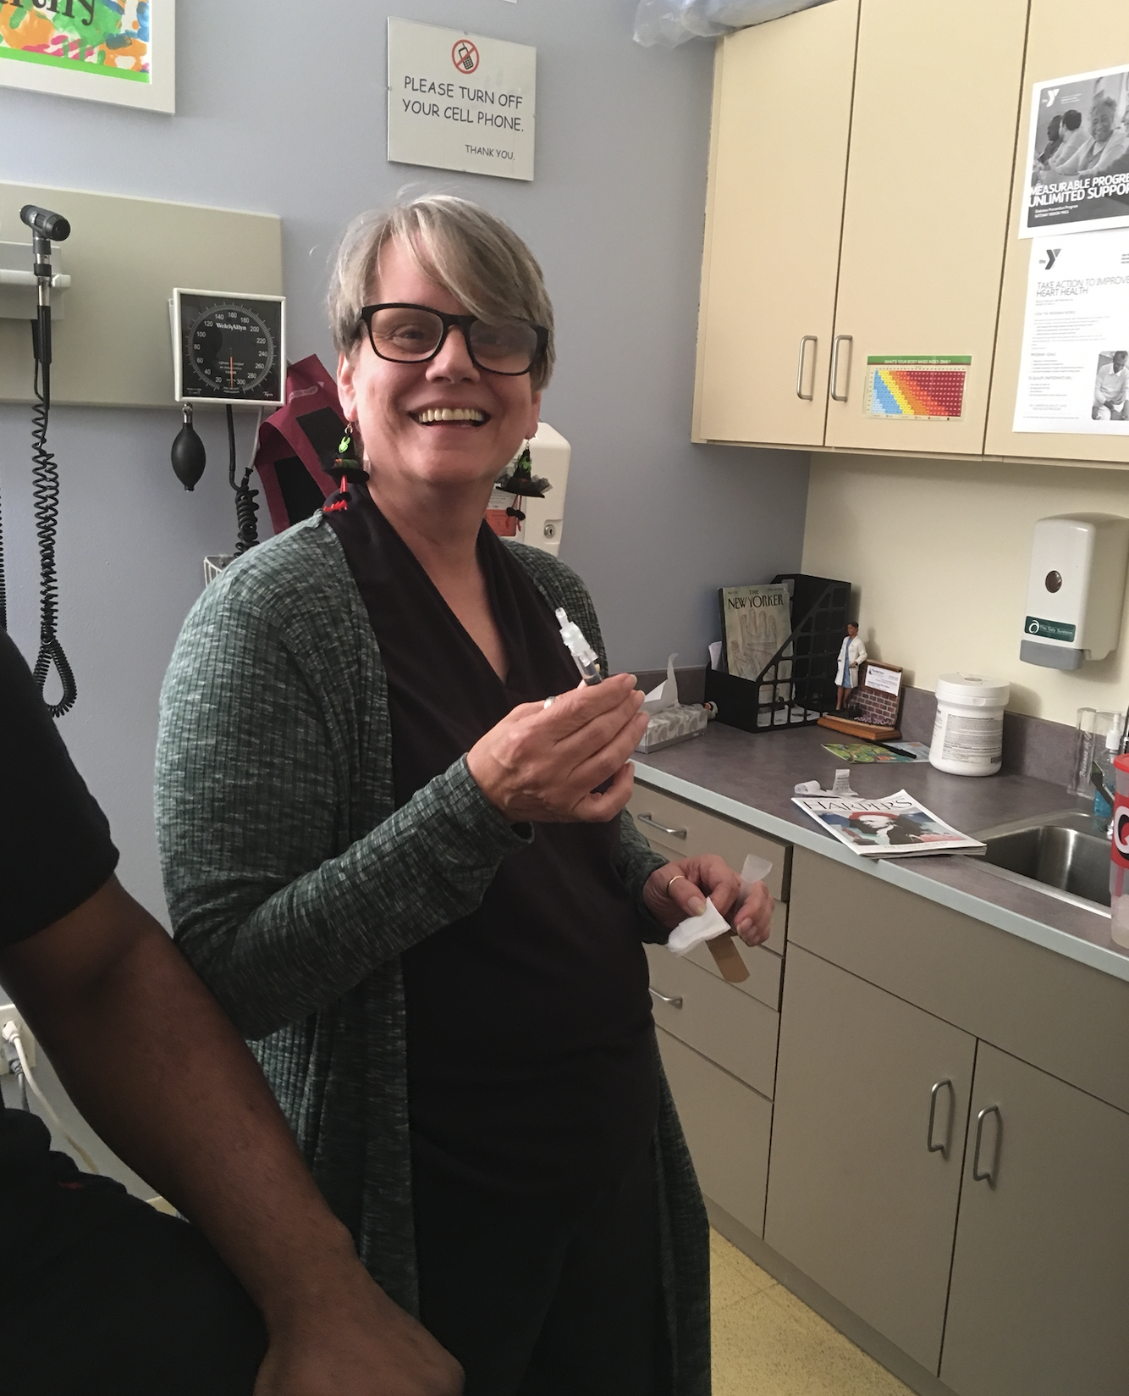
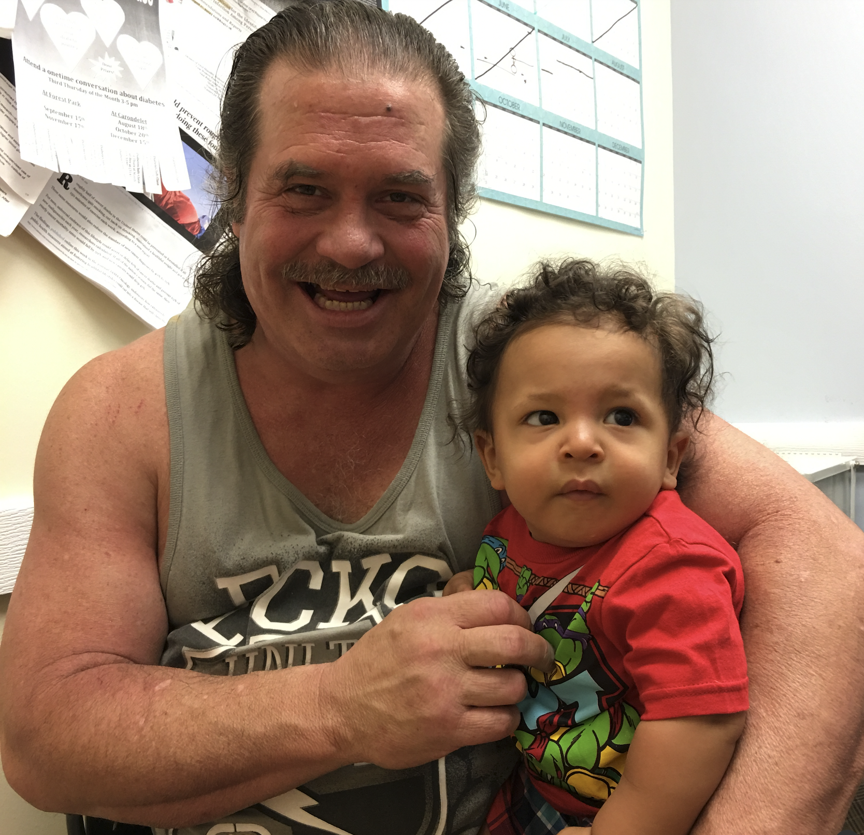
Thank you for everything you do for our children.
Notes:
For my patients

Slide 6
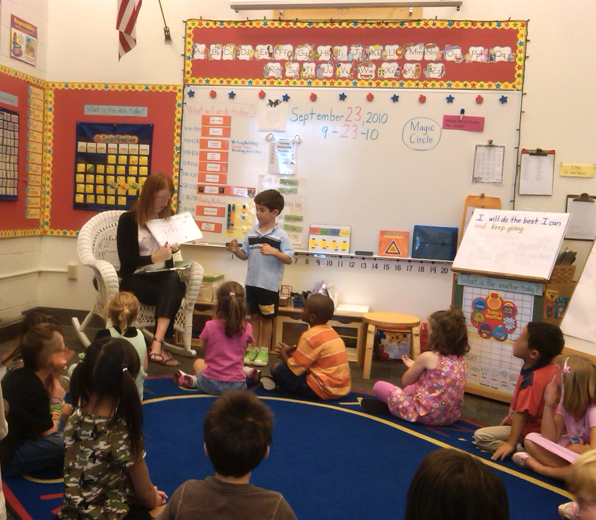
Thank you for everything you do for our children.
Notes:
For my children

Slide 7
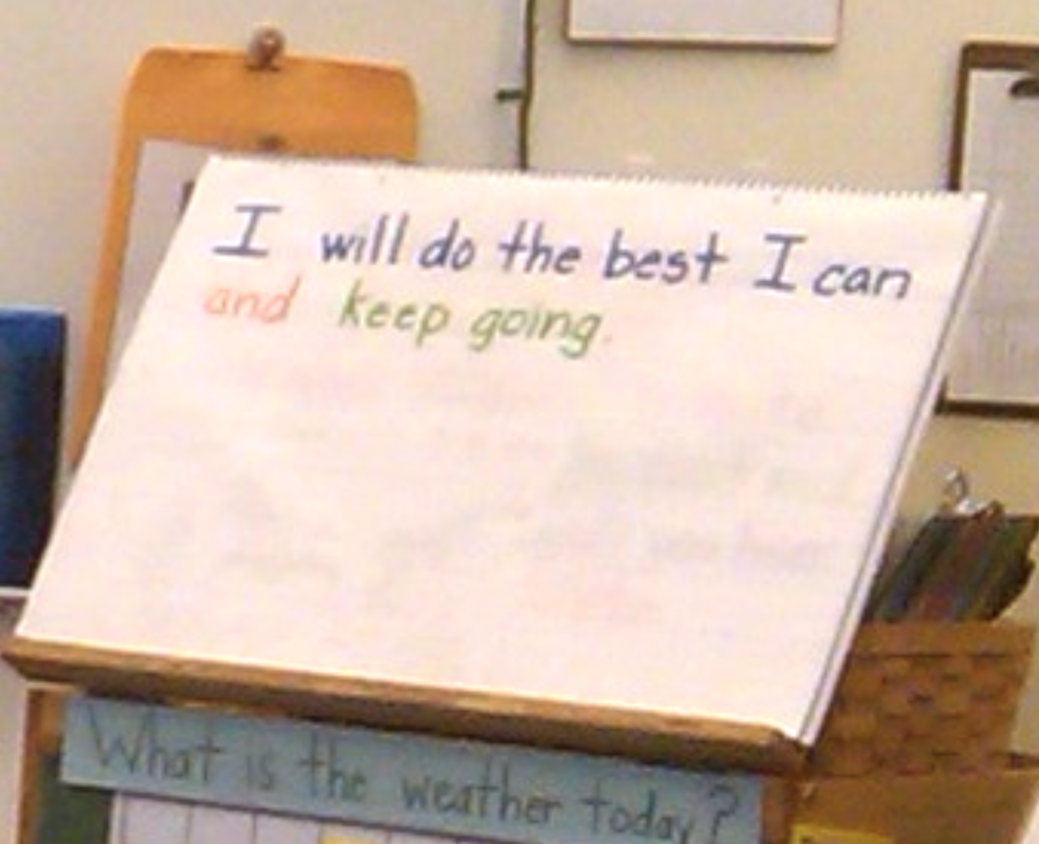
Thank you for everything you do for our children.

Slide 8
6+++++
Agenda
Tribute to You
We are a Team
State of our Children’s Health
Mortality
Risky Behaviors, Safety, Violence
Chronic Conditions - Mental Health
Social Determinants of Health
Looking Forward

Slide 9
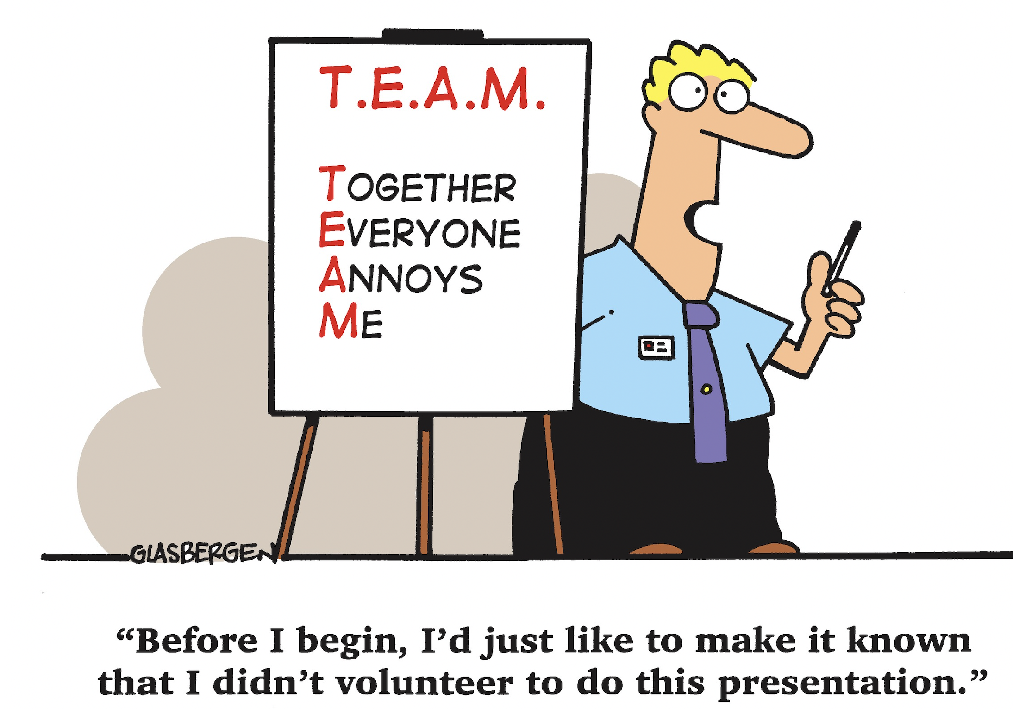
Team Based Care

Slide 10
Team Based Care

Slide 11
6+++++
Agenda
Tribute to You
We are a Team
State of our Children’s Health
Mortality
Risky Behaviors, Safety, Violence
Chronic Conditions - Mental Health
Social Determinants of Health
Looking Forward

Slide 12
Mortality Indicators
Missouri’s Vital Statistics Death Certificate data can give valuable insights into some of the state’s more vulnerable populations.
This analysis was performed comparing age groups for school aged children (ages 6 to 15).

Slide 13
All Causes of Death
In Missouri, there was a total of 344,755 deaths between 2018-2022 time period.
During this time, school aged children 6-15 accounted for 754 of these deaths.
Important to break this group into age groups to identify differences in leading causes.
FROM 2018 TO 2022, DEATHS TO SCHOOL AGED CHILDREN
INCREASED
BY
18.2%

Slide 14
Accidental/Unintentional Injury
The leading cause of death for 6-15 years old
This age group had an overall rate of 5.9 per 100,000 residents for deaths due to accidental/unintentional injury.
1st
- Over half were Motor Vehicle Accidents.
2nd
Accidental drownings ranked 2nd at 13.5%.
By age sub-group:
6-12 age group, drowning ranked 2nd
13-15 age group, accidental poisonings ranked 2nd
Notes:
Rural had rate of 66.1, slightly higher than urban at 64.3.

Slide 15
Cancer
2013-2017
Cancer was the 2nd leading cause of death for the 6 to 15 age group.
2018-2022
Cancer was not in the top three leading causes of death for the 6 to 15 age group
However, it was the 2nd leading cause for the 6 to 12 age group.
The leading types of cancer age 6-15
Meninges, brain, and other parts of the central nervous system.
Leukemia

Slide 16
Homicide
2013-2017
4th leading cause of death
2018-2022
3rd leading cause of death
homicide death rate of 2.6 per 100,000
When breaking into age sug-groups
2013-2017.
13-to-15-year olds had double the rate vs 6-to-12
2018-2022
13-to-15-year rate 4X higher than the rate for 6-to-12.
Rates are per 100,000 residents

Slide 17
Suicide
Suicide was the
3rd leading cause of death for the 6-to-15-year age group in 2013-2017
2nd leading cause of death for this age group in 2018-2022.
Breaking down that age group, the rate of death due to suicide for the 13- to 15-year-olds was over 10 times higher than the rate of those aged 6 to 12 for both 5- year periods.
Males ages 6 to 15 had counts double those of females in this age group for the 2018-2022 time period.
Rates are per 100,000 residents
*Indicates a rate is unreliable due to a count of less than 20.

Slide 18
Drug Overdose
Drug overdose death 4 means:
Accidental
Suicide
Homicide
Undetermined Intent
From 2018 to 2022, 83% of all drug overdose deaths for school aged children were accidental.

Slide 19
Drug Overdose
Drug overdose death 4 means:
Accidental
Suicide
Homicide
Undetermined Intent
2018-2022 time
- 24 children ages 6-15 died - drug overdose.
While this number may seem small, this was a
from the previous 5-year time period.
71.4%
INCREASE
From 2018 to 2022, 83% of all drug overdose deaths for school aged children were accidental.

Slide 20
6+++++
Agenda
Tribute to You
We are a Team
State of our Children’s Health
Mortality
Risky Behaviors, Safety, Violence
Chronic Conditions - Mental Health
Social Determinants of Health
Looking Forward

Slide 21
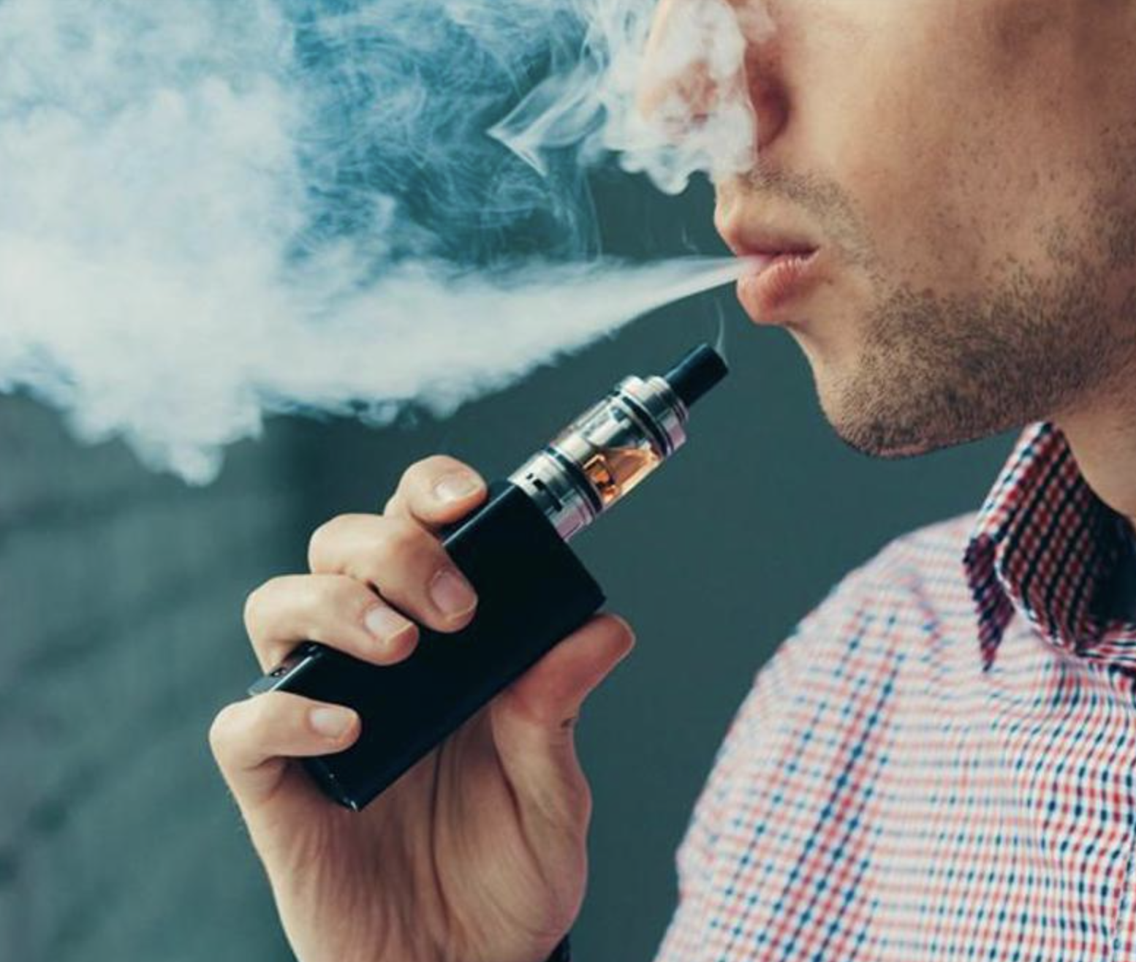
High School Students Who Ever Used an
Electronic Vapor Product
Including e-cigarettes, vapes, vape pens, e-cigars, e-hookahs, hookah pens, and mods [such as JUUL, SMOK, Suorin, Vuse, and blu]
10th > 9th, 11th > 9th, 12th > 9th (Based on t-test analysis, p < 0.05.)
All Hispanic students are included in the Hispanic category. All other races are non-Hispanic.
This graph contains weighted results.
Missouri - YRBS, 2015-2021
Notes:
Data for this slide are from the 2021 Missouri Youth Risk Behavior Survey. This slide shows the percentage of high school students who ever used an electronic vapor product (including e-cigarettes, vapes, vape pens, e-cigars, e-hookahs, hookah pens, and mods [such as JUUL, SMOK, Suorin, Vuse, and blu]).
The percentage for all students is 39.9. The percentage for Male students is 36.9. The percentage for Female students is 42.9. The percentage for 9th grade students is 27.0. The percentage for 10th grade students is 38.9. The percentage for 11th grade students is 47.4. The percentage for 12th grade students is 47.6. The percentage for Black students is 37.5. The percentage for Hispanic/Latino students is 38.1. The percentage for White students is 40.8. All Hispanic students are included in the Hispanic category. All other races are non-Hispanic. This graph contains weighted results.
For this behavior, the prevalence for 10th grade students is higher than for 9th grade students. The prevalence for 11th grade students is higher than for 9th grade students. The prevalence for 12th grade students is higher than for 9th grade students. (Based on t-test analysis, p < 0.05.)

Slide 22
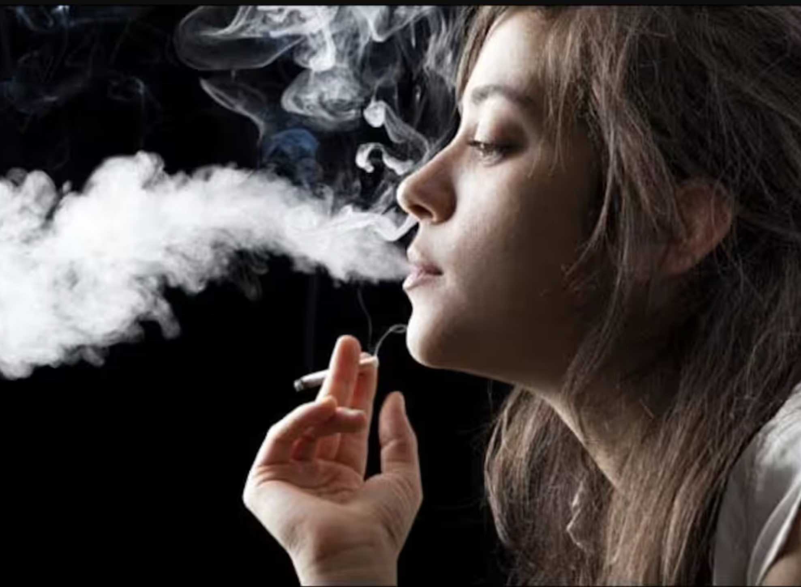
High School Students Who Currently
Smoked Cigarettes or Cigars
or Used Smokeless Tobacco
or Electronic Vapor Products
On at least 1 day during the 30 days before the survey
11th > 9th, 12th > 9th (Based on t-test analysis, p < 0.05.)
All Hispanic students are included in the Hispanic category. All other races are non-Hispanic.
This graph contains weighted results.
Missouri - YRBS, 2021 - QNTB4
Notes:
Data for this slide are from the 2021 Missouri Youth Risk Behavior Survey. This slide shows the percentage of high school students who currently smoked cigarettes or cigars or used smokeless tobacco or electronic vapor products (on at least 1 day during the 30 days before the survey).
The percentage for all students is 21.3. The percentage for Male students is 20.3. The percentage for Female students is 22.5. The percentage for 9th grade students is 12.1. The percentage for 10th grade students is 19.3. The percentage for 11th grade students is 26.9. The percentage for 12th grade students is 28.2. The percentage for Black students is 13.6. The percentage for Hispanic/Latino students is 17.9. The percentage for White students is 24.4. All Hispanic students are included in the Hispanic category. All other races are non-Hispanic. This graph contains weighted results.
For this behavior, the prevalence for 11th grade students is higher than for 9th grade students. The prevalence for 12th grade students is higher than for 9th grade students. (Based on t-test analysis, p < 0.05.)

Slide 23
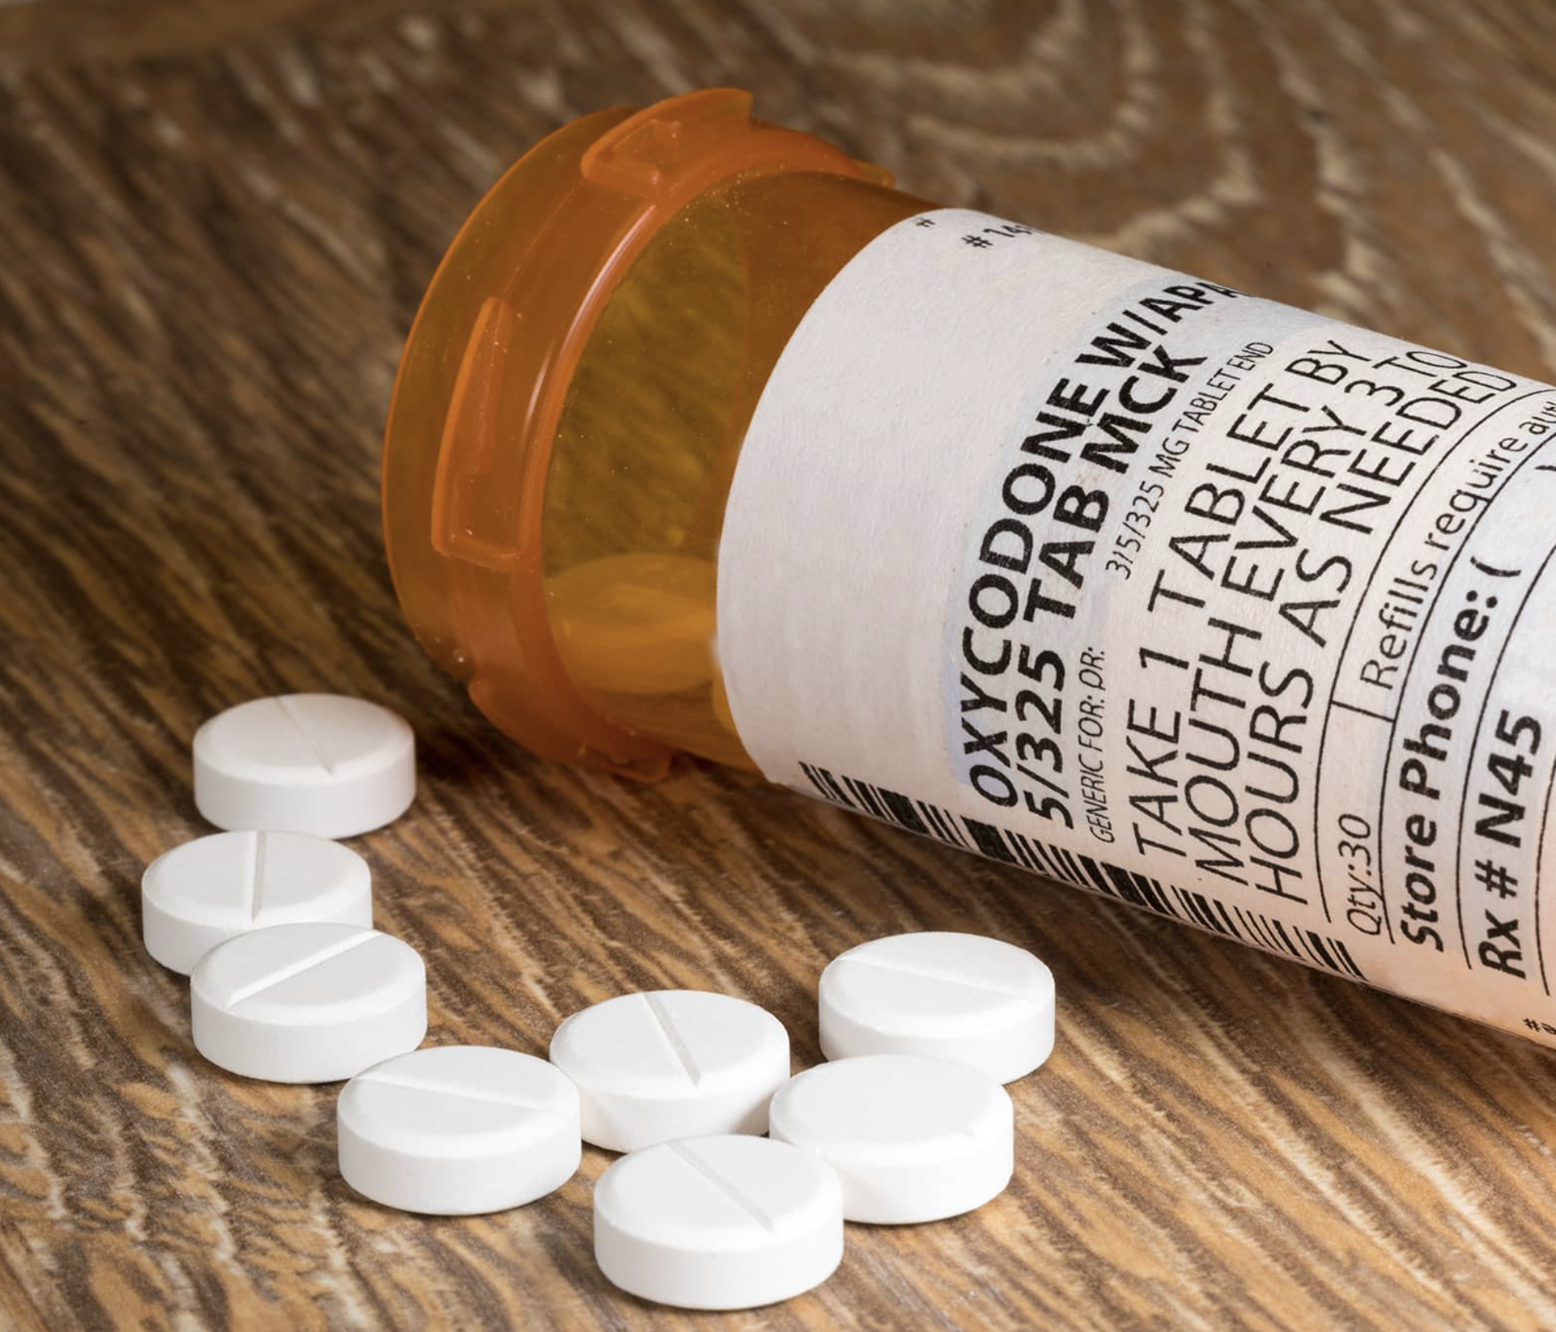
High School Students Who Ever Took
Prescription Pain Medicine Without a Dr’s Rx or Differently Than How a Dr Told Them to Use It
Counting drugs such as codeine, Vicodin, OxyContin, Hydrocodone, and Percocet, one or more times during their life
F > M (Based on t-test analysis, p < 0.05.)
All Hispanic students are included in the Hispanic category. All other races are non-Hispanic.
This graph contains weighted results.
Missouri - YRBS, 2021 - QN49
Notes:
Data for this slide are from the 2021 Missouri Youth Risk Behavior Survey. This slide shows the percentage of high school students who ever took prescription pain medicine without a doctor's prescription or differently than how a doctor told them to use it (counting drugs such as codeine, Vicodin, OxyContin, Hydrocodone, and Percocet, one or more times during their life).
The percentage for all students is 16.8. The percentage for Male students is 13.3. The percentage for Female students is 20.2. The percentage for 9th grade students is 19.3. The percentage for 10th grade students is 15.8. The percentage for 11th grade students is 16.6. The percentage for 12th grade students is 15.0. The percentage for Black students is 23.4. The percentage for Hispanic/Latino students is 20.4. The percentage for White students is 15.3. All Hispanic students are included in the Hispanic category. All other races are non-Hispanic. This graph contains weighted results.
For this behavior, the prevalence for female students is higher than for male students. (Based on t-test analysis, p < 0.05.)

Slide 24
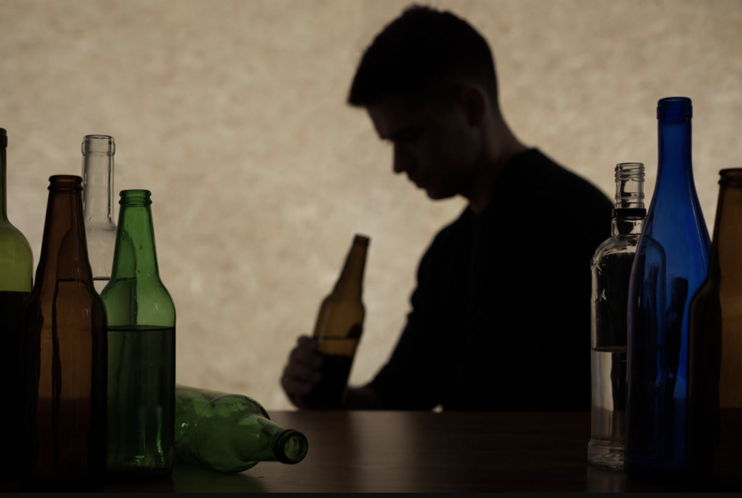
High School Students Who Currently Engage in Binge Drinking - 2021
Had four or more drinks of alcohol in a row if they were female or five or more drinks of alcohol in a row if they were male, within a couple of hours, on at least 1 day during the 30 days before the survey
11th > 9th, 12th > 9th, 12th > 10th; W > B (Based on t-test analysis, p < 0.05.)
All Hispanic students are included in the Hispanic category. All other races are non-Hispanic.
This graph contains weighted results.
Missouri - YRBS, 2017-2021
Notes:
Data for this slide are from the 2021 Missouri Youth Risk Behavior Survey. This slide shows the percentage of high school students who currently were binge drinking (had four or more drinks of alcohol in a row if they were female or five or more drinks of alcohol in a row if they were male, within a couple of hours, on at least 1 day during the 30 days before the survey).
The percentage for all students is 14.1. The percentage for Male students is 12.7. The percentage for Female students is 15.7. The percentage for 9th grade students is 8.3. The percentage for 10th grade students is 11.0. The percentage for 11th grade students is 16.2. The percentage for 12th grade students is 21.8. The percentage for Black students is 5.0. The percentage for Hispanic/Latino students is 13.1. The percentage for White students is 16.4. All Hispanic students are included in the Hispanic category. All other races are non-Hispanic. This graph contains weighted results.
For this behavior, the prevalence for 11th grade students is higher than for 9th grade students. The prevalence for 12th grade students is higher than for 9th grade students. The prevalence for 12th grade students is higher than for 10th grade students. The prevalence for White students is higher than for Black students. (Based on t-test analysis, p < 0.05.)

Slide 25
Safety and Violence in High School Students, 2021
Percentage of high school students who: | 2015 | 2017 | 2019 | 2021 | Trend*
Drove a vehicle when they had been drinking alcohol in the past 30 days | 6.8 | 5.3 | 4.2 | 4.3
Rode with a driver who was texting or e-mailing while driving in the past 30 days | - | 65.1 | 63.7 | 59.6 | NC
Did not go to school because of safety concerns in the past 30 days (at least one day) | 6.1 | 6.4 | 6.4 | 8.9
Experienced physical dating violence in the past 12 months (among students who dated) | 11.7 | 10.4 | 8.4 | 7.1
Bullied on school property in past 12 months | 21.4 | 23.3 | 21.0 | 15.4
Electronically bullied in the past 12 months | 16.6 | 19.4 | 18.1 | 13.9
Missouri - YRBS, 2015-2021

Slide 26
6+++++
Agenda
Tribute to You
We are a Team
State of our Children’s Health
Mortality
Risky Behaviors, Safety, Violence
Chronic Conditions - Mental Health
Social Determinants of Health
Looking Forward

Slide 27
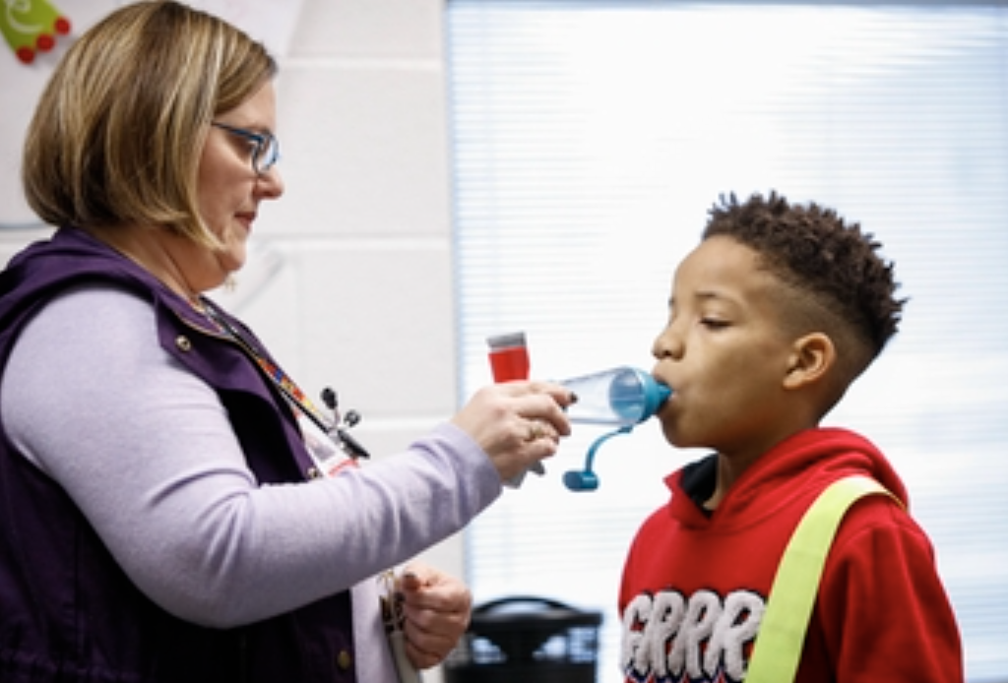
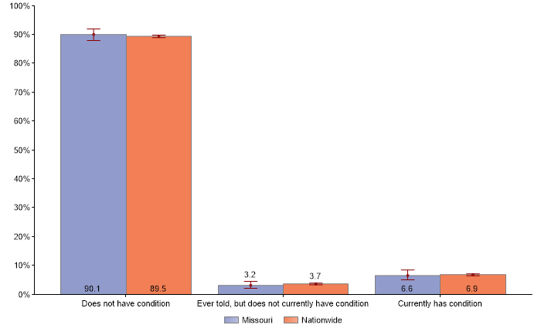
Asthma Prevalence in Children
Missouri vs. National
(0-17 years of age)

Slide 28
Asthma Prevalence in Children
Missouri vs. National
(0-17 years of age)

Slide 29
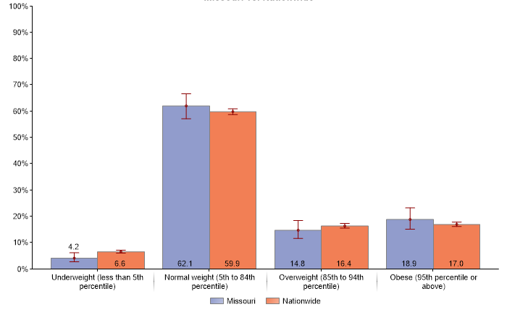
Weight Status based on BMI for Age: Overweight & Obese
Missouri vs. National

Slide 30
Weight Status based on BMI for Age: Overweight & Obese
Missouri vs. National

Slide 31
Weight Status based on BMI for Age: Overweight & Obese
Missouri vs. National
1/3
of MO children are obese or overweight

Slide 32
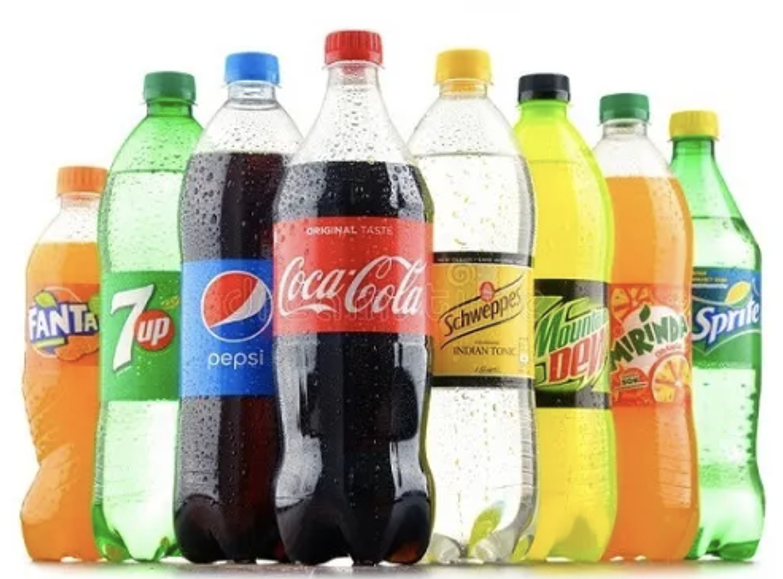
Weight Status based on BMI for Age: Overweight & Obese
Missouri vs. National

Slide 33
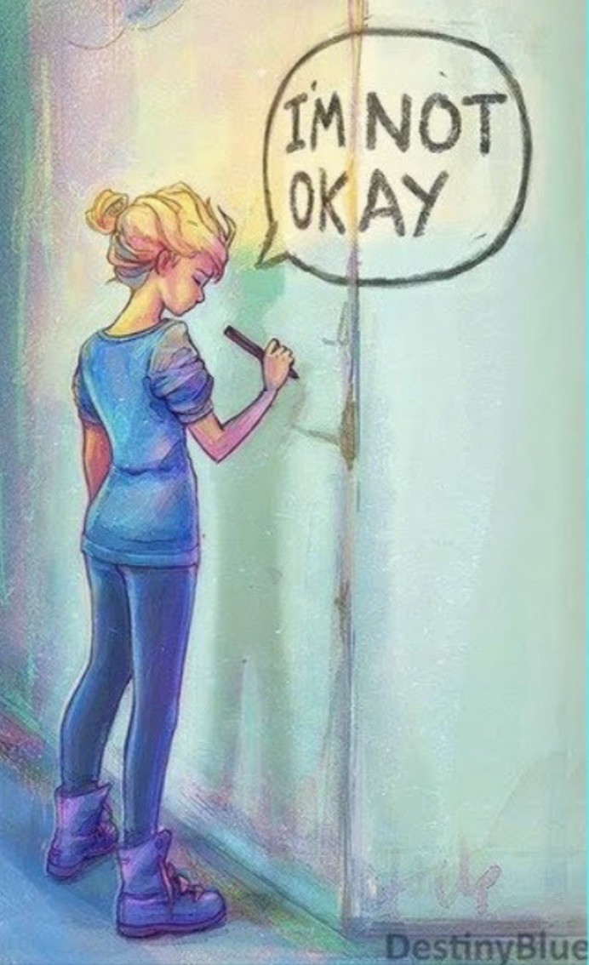
Mental
Health

Slide 34
High School Students Who Reported That Their
Mental Health Was Not Good
Including stress, depression, and problems with emotions, on at least 1 day during the 30 days before the survey
F > M; H > B, W > B (Based on t-test analysis, p < 0.05.)
All Hispanic students are included in the Hispanic category. All other races are non-Hispanic.
This graph contains weighted results.
Missouri - YRBS, 2021 - QN90
Notes:
Data for this slide are from the 2021 Missouri Youth Risk Behavior Survey. This slide shows the percentage of high school students who reported that their mental health was not good (including stress, depression, and problems with emotions, on at least 1 day during the 30 days before the survey).
The percentage for all students is 73.7. The percentage for Male students is 59.5. The percentage for Female students is 88.3. The percentage for 9th grade students is 67.1. The percentage for 10th grade students is 72.8. The percentage for 11th grade students is 79.1. The percentage for 12th grade students is 77.5. The percentage for Black students is 59.1. The percentage for Hispanic/Latino students is 78.0. The percentage for White students is 75.7. All Hispanic students are included in the Hispanic category. All other races are non-Hispanic. This graph contains weighted results.
For this behavior, the prevalence for female students is higher than for male students. The prevalence for Hispanic students is higher than for Black students. The prevalence for White students is higher than for Black students. (Based on t-test analysis, p < 0.05.)

Slide 35
Children (3-17 years old) Who Received Mental Health Care During the Past 12 Months
Missouri vs. National
Yes
No, but needed to see a mental health professional
No, did not need to see a mental health professional

Slide 36
Children (3-17 years old) Who Received Mental Health Care During the Past 12 Months
Missouri vs. National
Yes
No, but needed to see a mental health professional
No, did not need to see a mental health professional

Slide 37
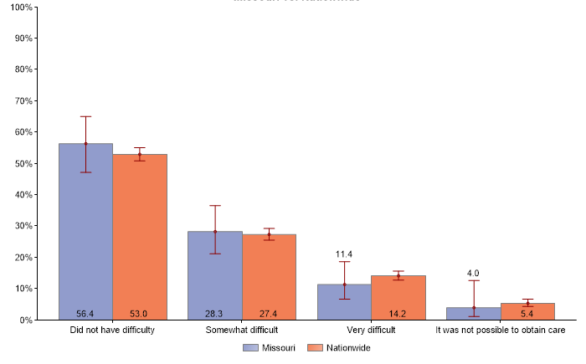
Children (3-17 years old) Who Experienced Difficulties Obtaining Mental Health Care*
Missouri vs. National
* Among children who received or needed any mental health treatment or counseling
Notes:
Data for this slide are from the 2021 Missouri Youth Risk Behavior Survey. This slide shows the percentage of high school students who currently smoked cigarettes or cigars or used smokeless tobacco or electronic vapor products (on at least 1 day during the 30 days before the survey).
The percentage for all students is 21.3. The percentage for Male students is 20.3. The percentage for Female students is 22.5. The percentage for 9th grade students is 12.1. The percentage for 10th grade students is 19.3. The percentage for 11th grade students is 26.9. The percentage for 12th grade students is 28.2. The percentage for Black students is 13.6. The percentage for Hispanic/Latino students is 17.9. The percentage for White students is 24.4. All Hispanic students are included in the Hispanic category. All other races are non-Hispanic. This graph contains weighted results.
For this behavior, the prevalence for 11th grade students is higher than for 9th grade students. The prevalence for 12th grade students is higher than for 9th grade students. (Based on t-test analysis, p < 0.05.)

Slide 38
Children (3-17 years old) Who Experienced Difficulties Obtaining Mental Health Care*
Missouri vs. National
* Among children who received or needed any mental health treatment or counseling
Notes:
Data for this slide are from the 2021 Missouri Youth Risk Behavior Survey. This slide shows the percentage of high school students who currently smoked cigarettes or cigars or used smokeless tobacco or electronic vapor products (on at least 1 day during the 30 days before the survey).
The percentage for all students is 21.3. The percentage for Male students is 20.3. The percentage for Female students is 22.5. The percentage for 9th grade students is 12.1. The percentage for 10th grade students is 19.3. The percentage for 11th grade students is 26.9. The percentage for 12th grade students is 28.2. The percentage for Black students is 13.6. The percentage for Hispanic/Latino students is 17.9. The percentage for White students is 24.4. All Hispanic students are included in the Hispanic category. All other races are non-Hispanic. This graph contains weighted results.
For this behavior, the prevalence for 11th grade students is higher than for 9th grade students. The prevalence for 12th grade students is higher than for 9th grade students. (Based on t-test analysis, p < 0.05.)

Slide 39
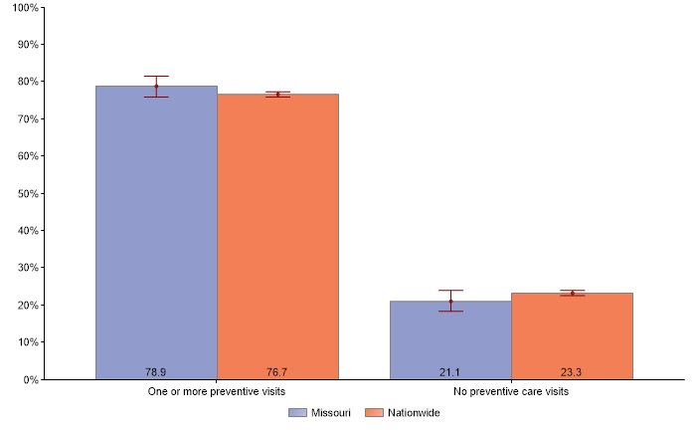
Children Who had One or More Preventative Care Visits During the Past 12 Months
Missouri vs. National

Slide 40
Children Who had One or More Preventative Care Visits During the Past 12 Months
Missouri vs. National
1/5
of MO children without preventive care visit

Slide 41
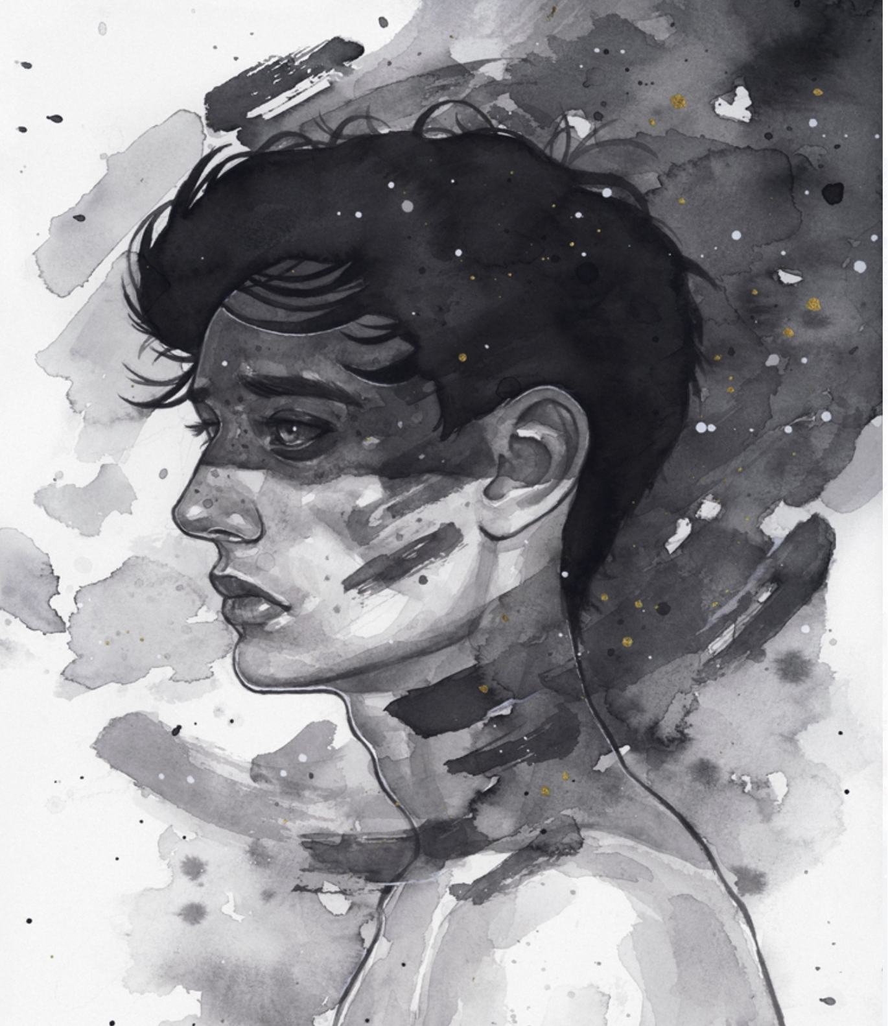
High School Students Who
Seriously Considered Attempting Suicide
During the 12 months before the survey
F > M; 11th > 9th, 11th > 10th (Based on t-test analysis, p < 0.05.)
All Hispanic students are included in the Hispanic category. All other races are non-Hispanic.
This graph contains weighted results.
Missouri - YRBS, 2017-2021
Notes:
Data for this slide are from the 2021 Missouri Youth Risk Behavior Survey. This slide shows the percentage of high school students who seriously considered attempting suicide (during the 12 months before the survey).
The percentage for all students is 20.4. The percentage for Male students is 15.2. The percentage for Female students is 25.5. The percentage for 9th grade students is 17.1. The percentage for 10th grade students is 20.1. The percentage for 11th grade students is 25.1. The percentage for 12th grade students is 19.4. The percentage for Black students is 22.8. The percentage for Hispanic/Latino students is 22.0. The percentage for White students is 19.0. All Hispanic students are included in the Hispanic category. All other races are non-Hispanic. This graph contains weighted results.
For this behavior, the prevalence for female students is higher than for male students. The prevalence for 11th grade students is higher than for 9th grade students. The prevalence for 11th grade students is higher than for 10th grade students. (Based on t-test analysis, p < 0.05.)

Slide 42
High School Students Who
Attempted Suicide
During the 12 months before the survey
F > M; 11th > 9th, 11th > 10th (Based on t-test analysis, p < 0.05.)
All Hispanic students are included in the Hispanic category. All other races are non-Hispanic.
This graph contains weighted results.
Missouri - YRBS, 2013-2021
Notes:
Data for this slide are from the 2021 Missouri Youth Risk Behavior Survey. This slide shows the percentage of high school students who attempted suicide (one or more times during the 12 months before the survey).
The percentage for all students is 8.7. The percentage for Male students is 4.6. The percentage for Female students is 13.0. The percentage for 9th grade students is 9.4. The percentage for 10th grade students is 8.4. The percentage for 11th grade students is 8.4. The percentage for 12th grade students is 9.0. The percentage for Black students is 12.9. The percentage for Hispanic/Latino students is 9.8. The percentage for White students is 6.8. All Hispanic students are included in the Hispanic category. All other races are non-Hispanic. This graph contains weighted results.
For this behavior, the prevalence for female students is higher than for male students. (Based on t-test analysis, p < 0.05.)

Slide 43
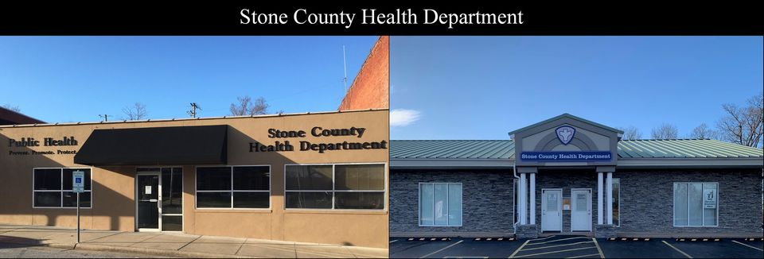
Stone County Health Department +
Galena R-II School District Partnership
Notes:
Stone County Health Department and Galena R-II School District to present here to Shelby County slides.
One example of working to address
promoting protective factors for youth and families and
reducing suicide and self-harm
is our partnership with the Stone County Health Department.
Through data collection and community input, the health department identified that
mental health, specifically suicide among children and adolescents, was a priority health issue they needed to address.
Health department partnered with local school districts in the county to
implement policy and organizational change
Ex：The health department worked with the Galena R-II School District to develop a policy that student name badges have the 988 message and other mental health resources on them
～500 students are in the district and now have this resource as part of their student badge
increase community and individual knowledge and skills.
QPR Suicide Prevention training has been provided to all 7th-12th graders -~300 students, the last two years, increasing early recognition of suicide warning signs and the skills to respond.”
More than 60% of students qualify for free or reduced school lunches
4-day school weeks due to staffing shortages

Slide 44
Achievements
as a Result of Partnership
Worked with Galena R-II school counselor to provide QPR Suicide Prevention Training to all 7th-12th graders at Galena R-II Middle and High School
Worked with Galena R-II School Counselor to provide QPR Suicide Prevention Training to all 7th-12th graders at Galena R-II Middle and High School, reaching over 300 students, staff, and teachers
Worked with Galena R-II to develop a policy that student name badges have the 988 message and other mental health resources printed on them. Approximately 500 students are in the district
Worked with Galena R-II and hosted an all-student assembly at the high school titled “The Dangers of Today’s Marijuana” by Laura Stack, founder of Johnny’s Ambassadors
2022
2023
2023
2023

Slide 45
6+++++
Agenda
Tribute to You
We are a Team
State of our Children’s Health
Mortality
Risky Behaviors, Safety, Violence
Chronic Conditions - Mental Health
Social Determinants of Health
Looking Forward

Slide 46
Social Determinants
= The conditions in the environments where people are born, live, learn, work, play, worship, and age that affect a wide range of health, functioning, and quality-of-life outcomes and risks.¹
The following data is summarized from the
U.S. Census Bureau and therefore cannot be broken out into smaller age groups other than what is provided.
1 Social Determinants of Health- Healthy People 2030.

Slide 47
Poverty
2017
2021
*Note: The Census Bureau did not release its standard 2020 ACS 1-year estimate because of the impacts of the COVID-19 pandemic.
In 2022, Missouri Ranked 34th in the U.S. for percent of the 5-17 year old below the poverty level.
Source: Office of the Assistant Secretary for Planning and Evaluation, U.S Census Bureau, Table S1701

Slide 48
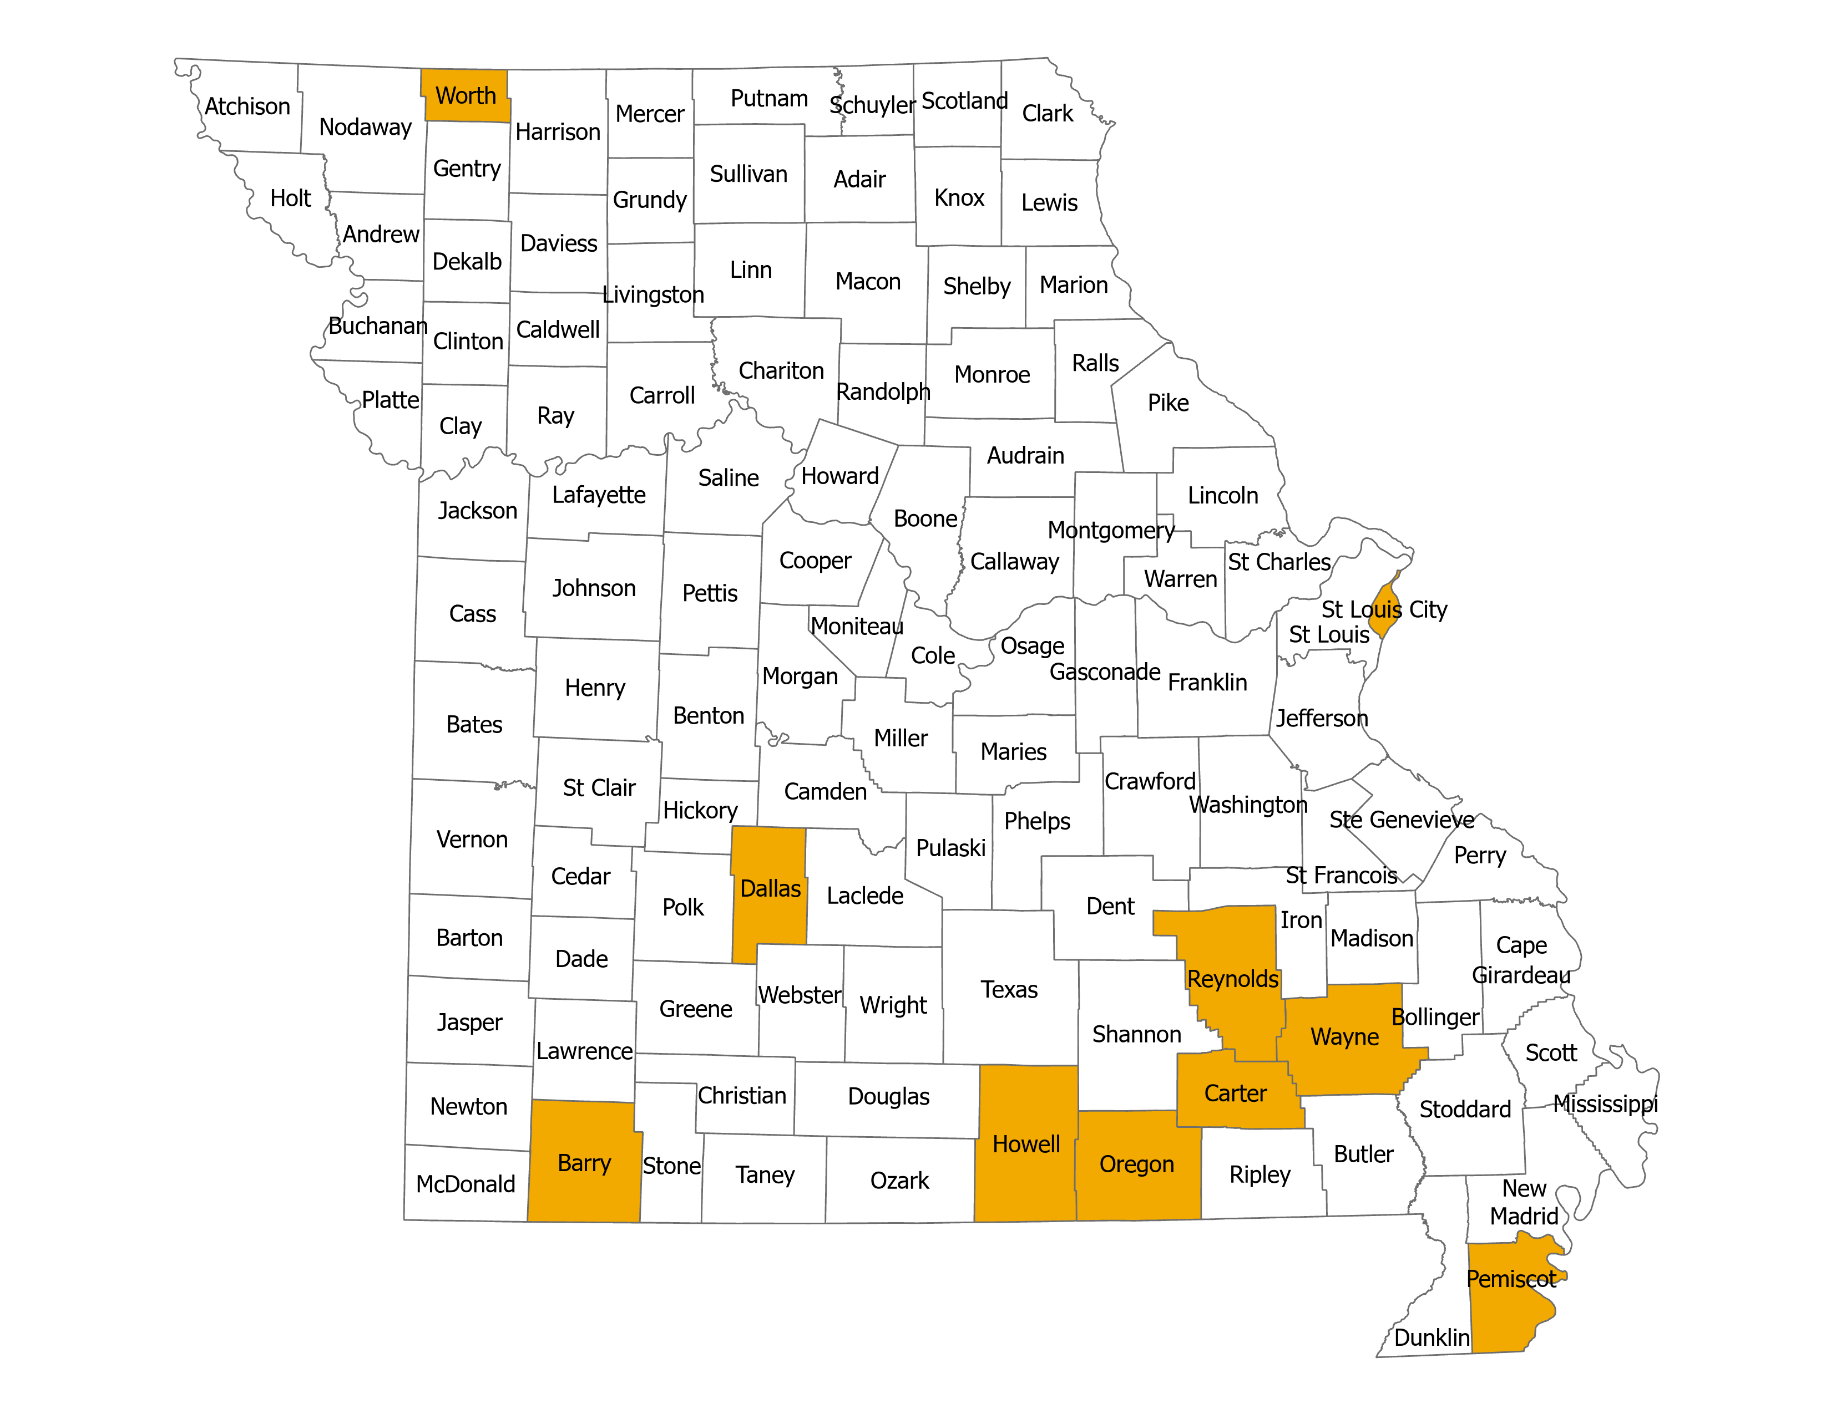
Poverty
10 Highest Poverty Rates in Missouri,
5-17 Population 2018-2022
29.3%-41.6%
2017
2021
*Note: The Census Bureau did not release its standard 2020 ACS 1-year estimate because of the impacts of the COVID-19 pandemic.
In 2022, Missouri Ranked 34th in the U.S. for percent of the 5-17 year old below the poverty level.
Source: Office of the Assistant Secretary for Planning and Evaluation, U.S Census Bureau, Table S1701

Slide 49
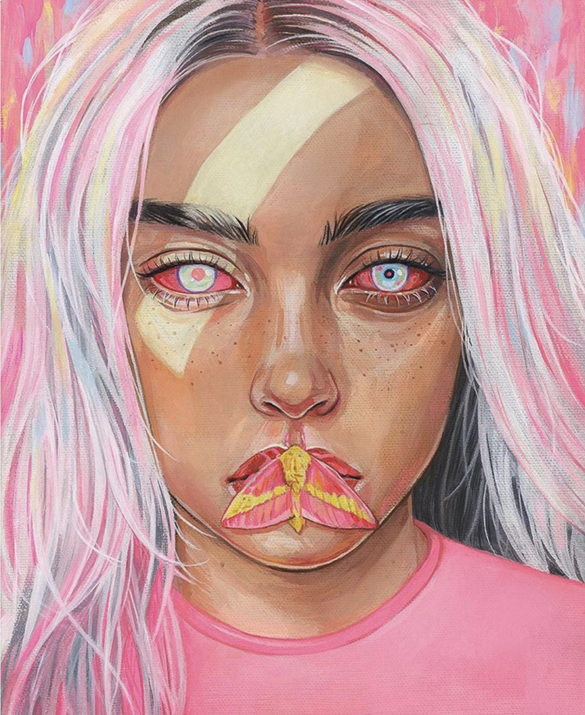
High School Students Who Most of the Time or Always
Went Hungry or
There Was Not Enough Food in Their Home
During Covid-19 Pandemic
All Hispanic students are included in the Hispanic category. All other races are non-Hispanic.
This graph contains weighted results.
Missouri - YRBS, 2021 - QN111
Notes:
Data for this slide are from the 2021 Missouri Youth Risk Behavior Survey. This slide shows percentages of high school students who most of the time or always went hungry or there was not enough food in their home during the COVID-19 pandemic.
The percentage for all students is 2.8. The percentage for Male students is 1.9. The percentage for Female students is 3.0. The percentage for 9th grade students is 3.3. The percentage for 10th grade students is 1.8. The percentage for 11th grade students is 3.6. The percentage for 12th grade students is 2.7. The percentage for Black students is 4.0. The percentage for Hispanic/Latino students is 2.3. The percentage for White students is 1.9. All Hispanic students are included in the Hispanic category. All other races are non-Hispanic. This graph contains weighted results.

Slide 50
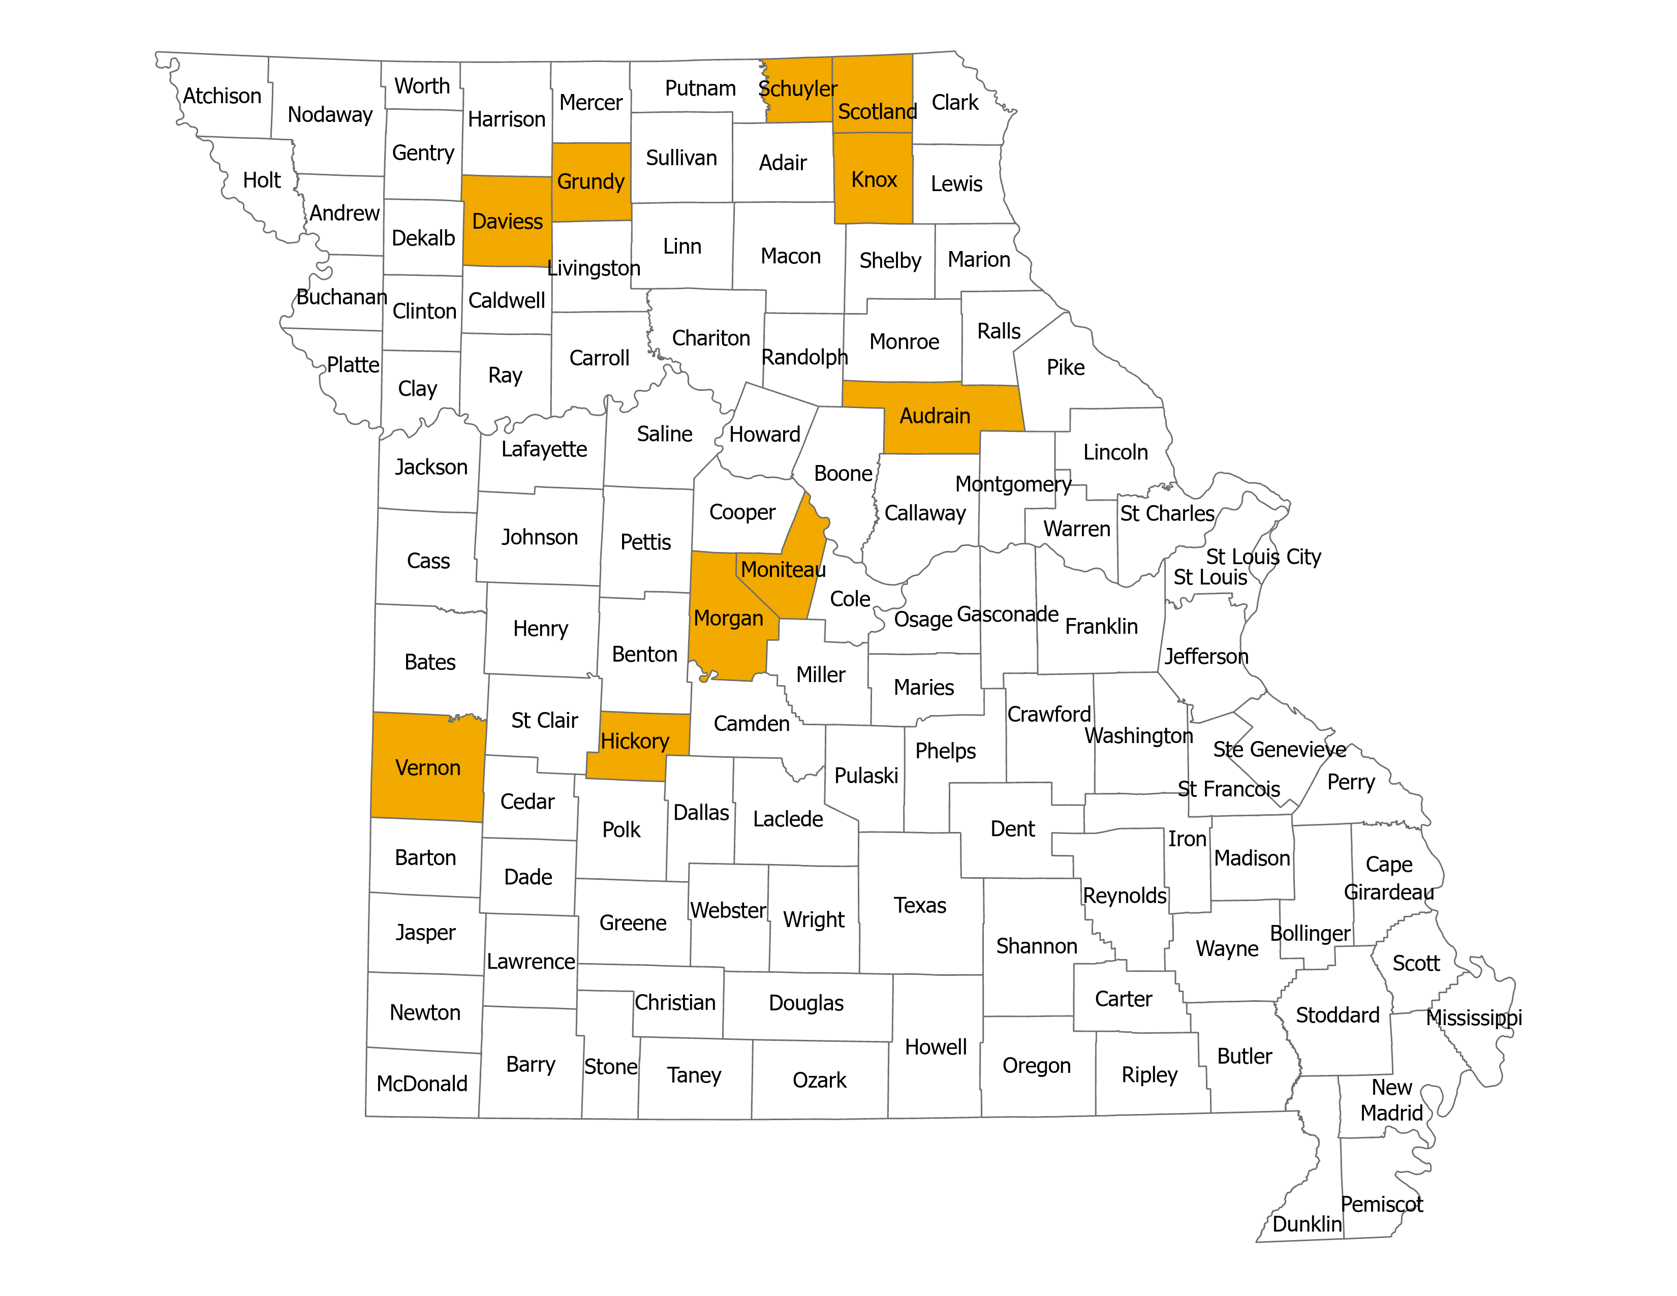
Uninsured
10 Highest Uninsured Rates in Missouri,
6-18 population
2018-2022
17.7%-40.4%
2017
2021
*Note: The Census Bureau did not release its standard 2020 ACS 1-year estimate because of the impacts of the COVID-19 pandemic.
In 2022, Missouri ranked 38th in the United States for percent of the 6-18 year old population without health insurance.
Source: U.S Census Bureau, Table S2701

Slide 51
6+++++
Agenda
Tribute to You
We are a Team
State of our Children’s Health
Mortality
Risky Behaviors, Safety, Violence
Chronic Conditions - Mental Health
Social Determinants of Health
Looking Forward

Slide 52
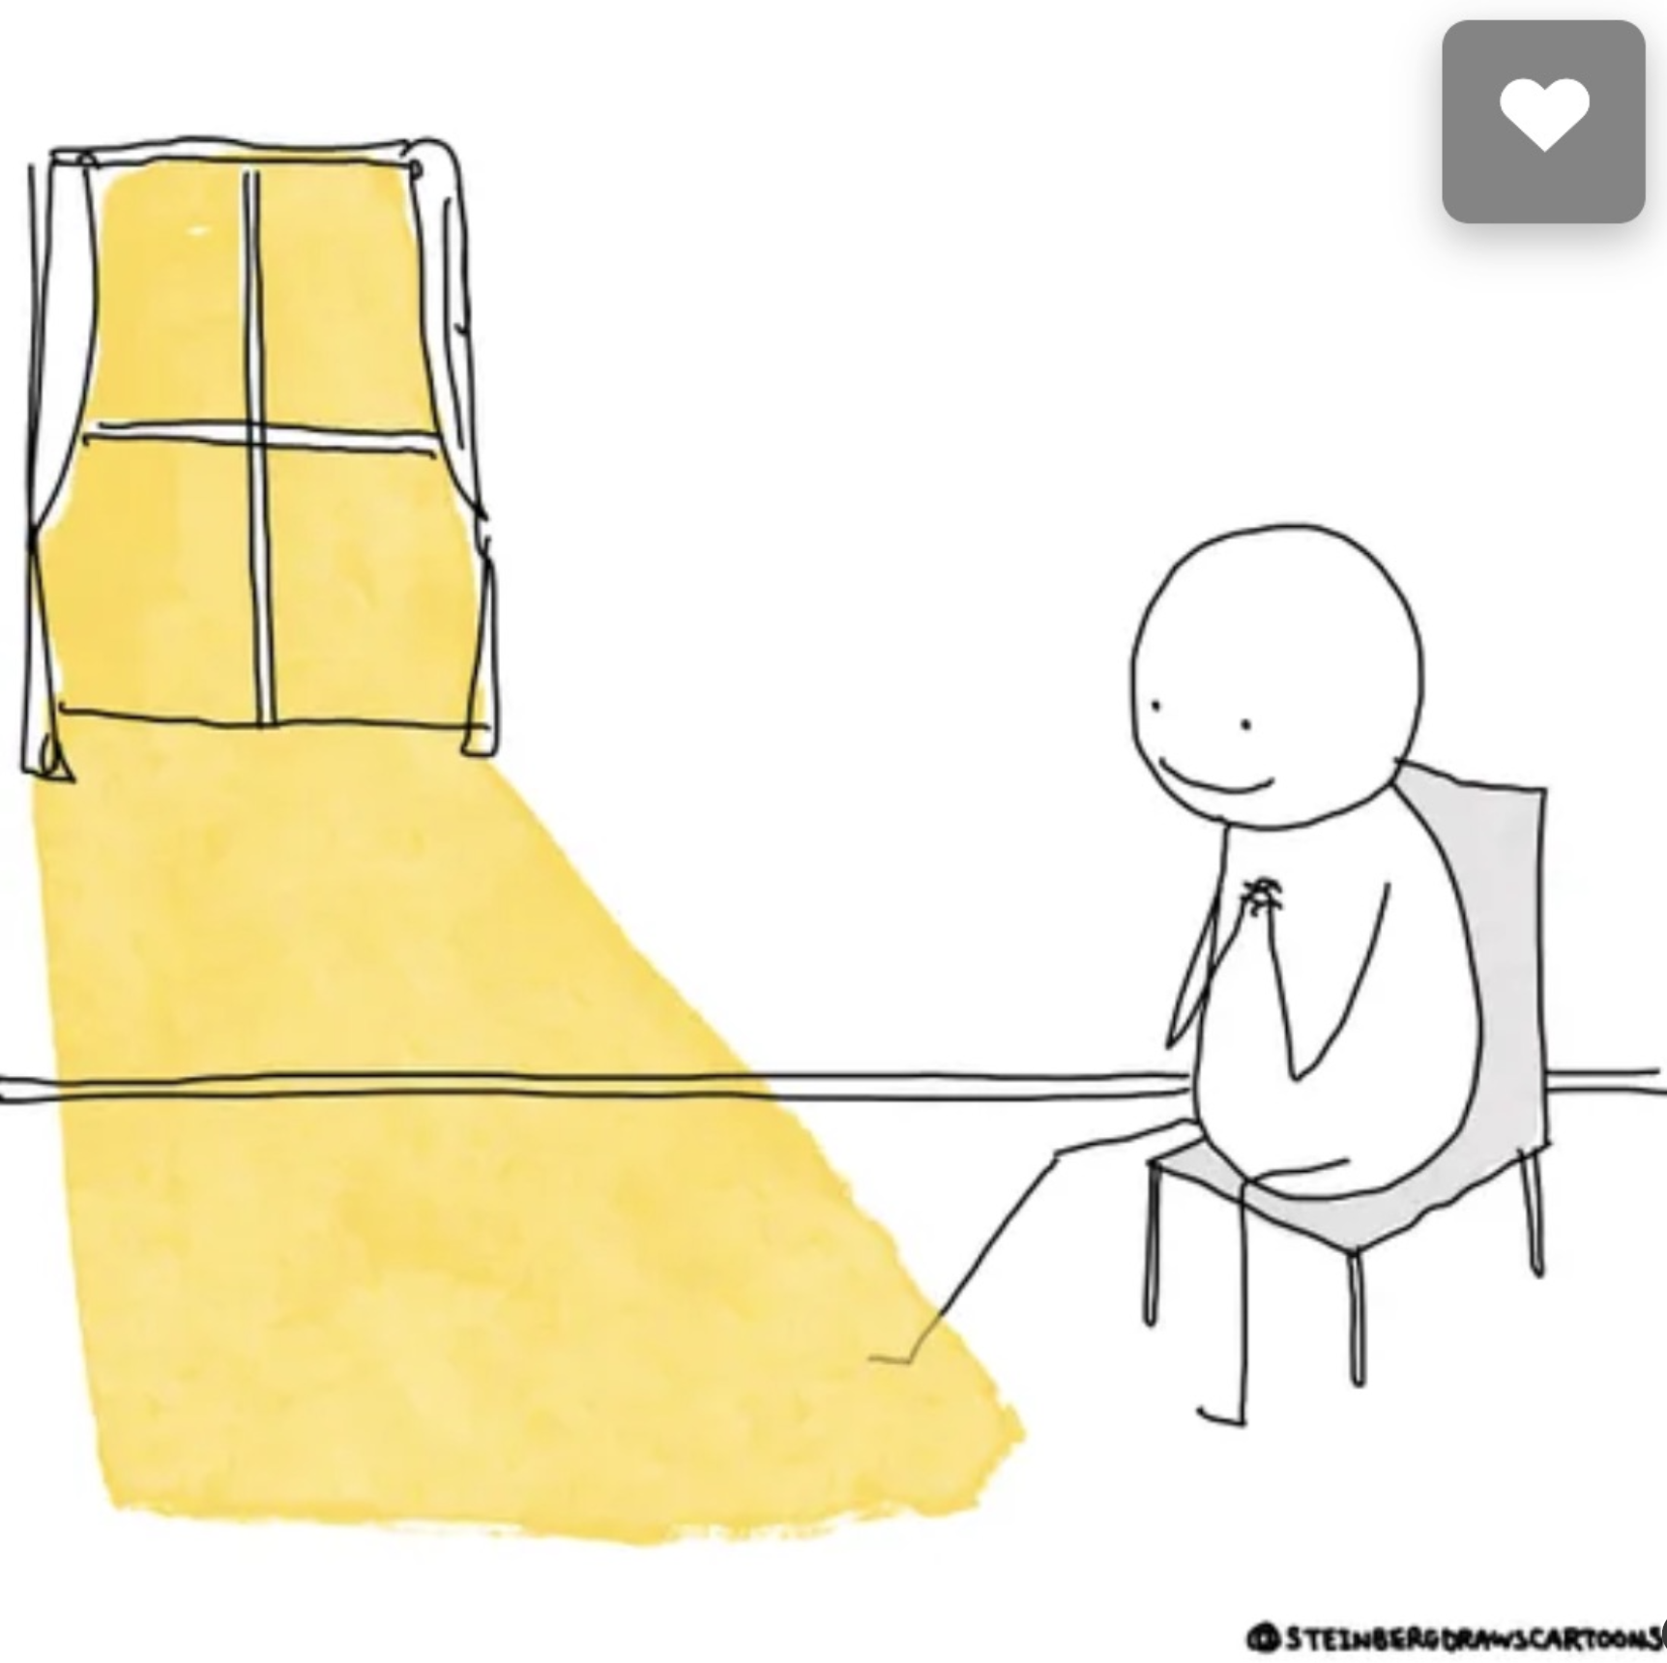
_____

Slide 53
DHSS Activities to Help Youth
School Health Program
Children & Youth with Special Health Care Needs Program
Family Partnership Program
Maternal Child Health Programs
ParentLink
Bureau of Communicable Disease
Healthy Water, Lead Removal, WIIN
Asthma Care Improvement
Dental Services
Health.mo.gov

Slide 54
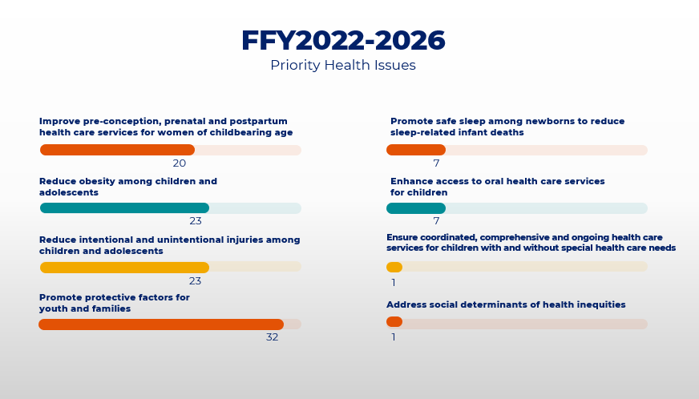
Your Local Public Health Agencies
(Maternal-Child Health Title V)
Notes:
The MCH Services Program is 100% funded by Title V MCH Block Grant funding.
Any LPHA in Missouri is eligible to participate in the Maternal Child Health (MCH) Services Contract
after completion and approval of a proposal referred to as the contract work plan and completion and approval of an annual contract budget.
DHSS currently partnering with 111 of the 115 local public health agencies in Missouri.
The purpose of the MCH Services contract is to support a leadership role for LPHAs at the local level to:
-build community-based systems
-expand the resources those systems can use to respond to priority maternal child health issues;
-provide and assure mothers and children (in particular those with low income or with limited availability of health services) access to quality MCH services;
-reduce health disparities for women, infants, and children, including those with special health care needs;
-promote the health of mothers and infants by assuring prenatal, delivery, and postpartum care for low income, at-risk pregnant women; and
-promote the health of children by providing preventive and primary care services for low income children.
The Contractor’s efforts to fulfill the purpose of the MCH Services contract will include activities and services that address the needs of children and youth with special health care needs (CYSHCN).
LPHAs have developed five-year work plans to address these priority health issues and are currently in year 3 of this work:
20 have selected improving pre-conception, prenatal and postpartum health care services for women of childbearing age
23 have selected reducing obesity among children and adolescents
23 have selected reducing intentional and unintentional injuries among children and adolescents
32 have selected promote protective factors for youth and families
7 have selected promoting safe-sleep among newborns to reduce sleep-related infant deaths
7 have selected enhancing access to oral health care services for children
1 has selected ensuring coordinated, comprehensive, and ongoing health care service for children with and without special health care needs
1 has selected addressing social determinants of health inequities
The picture depicts the story of the work of our LPHA partners- with the LPHA “driving” the change, serving women, children and families, including children and youth with special health care needs to improve health outcomes, and leaving no one behind.

Slide 55
ParentLink
TEL-LINK:
Maternal Child Health referrals
and services in your community
800-835-5465 – Call/Text | M-F 8-5
WarmLine
For parents, caregivers, and professionals
Family strengthening information and support solutions
800-552-8522 or text 585-FAMILY1
Mon–Fri 8am-10pm, Wknd 12-5
Access Navigation Assistance: Trained CHW navigators aid in accessing resources and supports in Bootheel
800-552-8522
Notes:
ParentLink connects families with supports and resources to help children thrive through a variety of services. Highlighted here are two hotlines (TEL-LINK and WarmLine) and the credentialed community health worker program, ParentLink Navigators.
TEL-LINK received 2,361 calls last year. Top issues addressed by TEL-LINK included: Housing (774), Transportation (533), and WIC (317).
In 2023, the WarmLine received over 4,500 calls! 60% of contactors were parents, 21% were professionals, all other individuals made up the remaining 19%. WarmLine calls covered a range of topics including Housing, Guardianship, and Parenting topics such as Development Stages and Separation Anxiety.
ParentLink Navigators provide clients with problem-solving support and follow-up on a variety of support services including access to Medicaid (485 contacts), SNAP benefits (64 contacts), Childcare subsidy applications (24 contacts), and TANF benefits (9 contacts).
1,009 children between the ages of 1-10 were supported through navigation services, 200 teens, 54 pregnancies, and 7 children/youth with special health care needs.

Slide 56
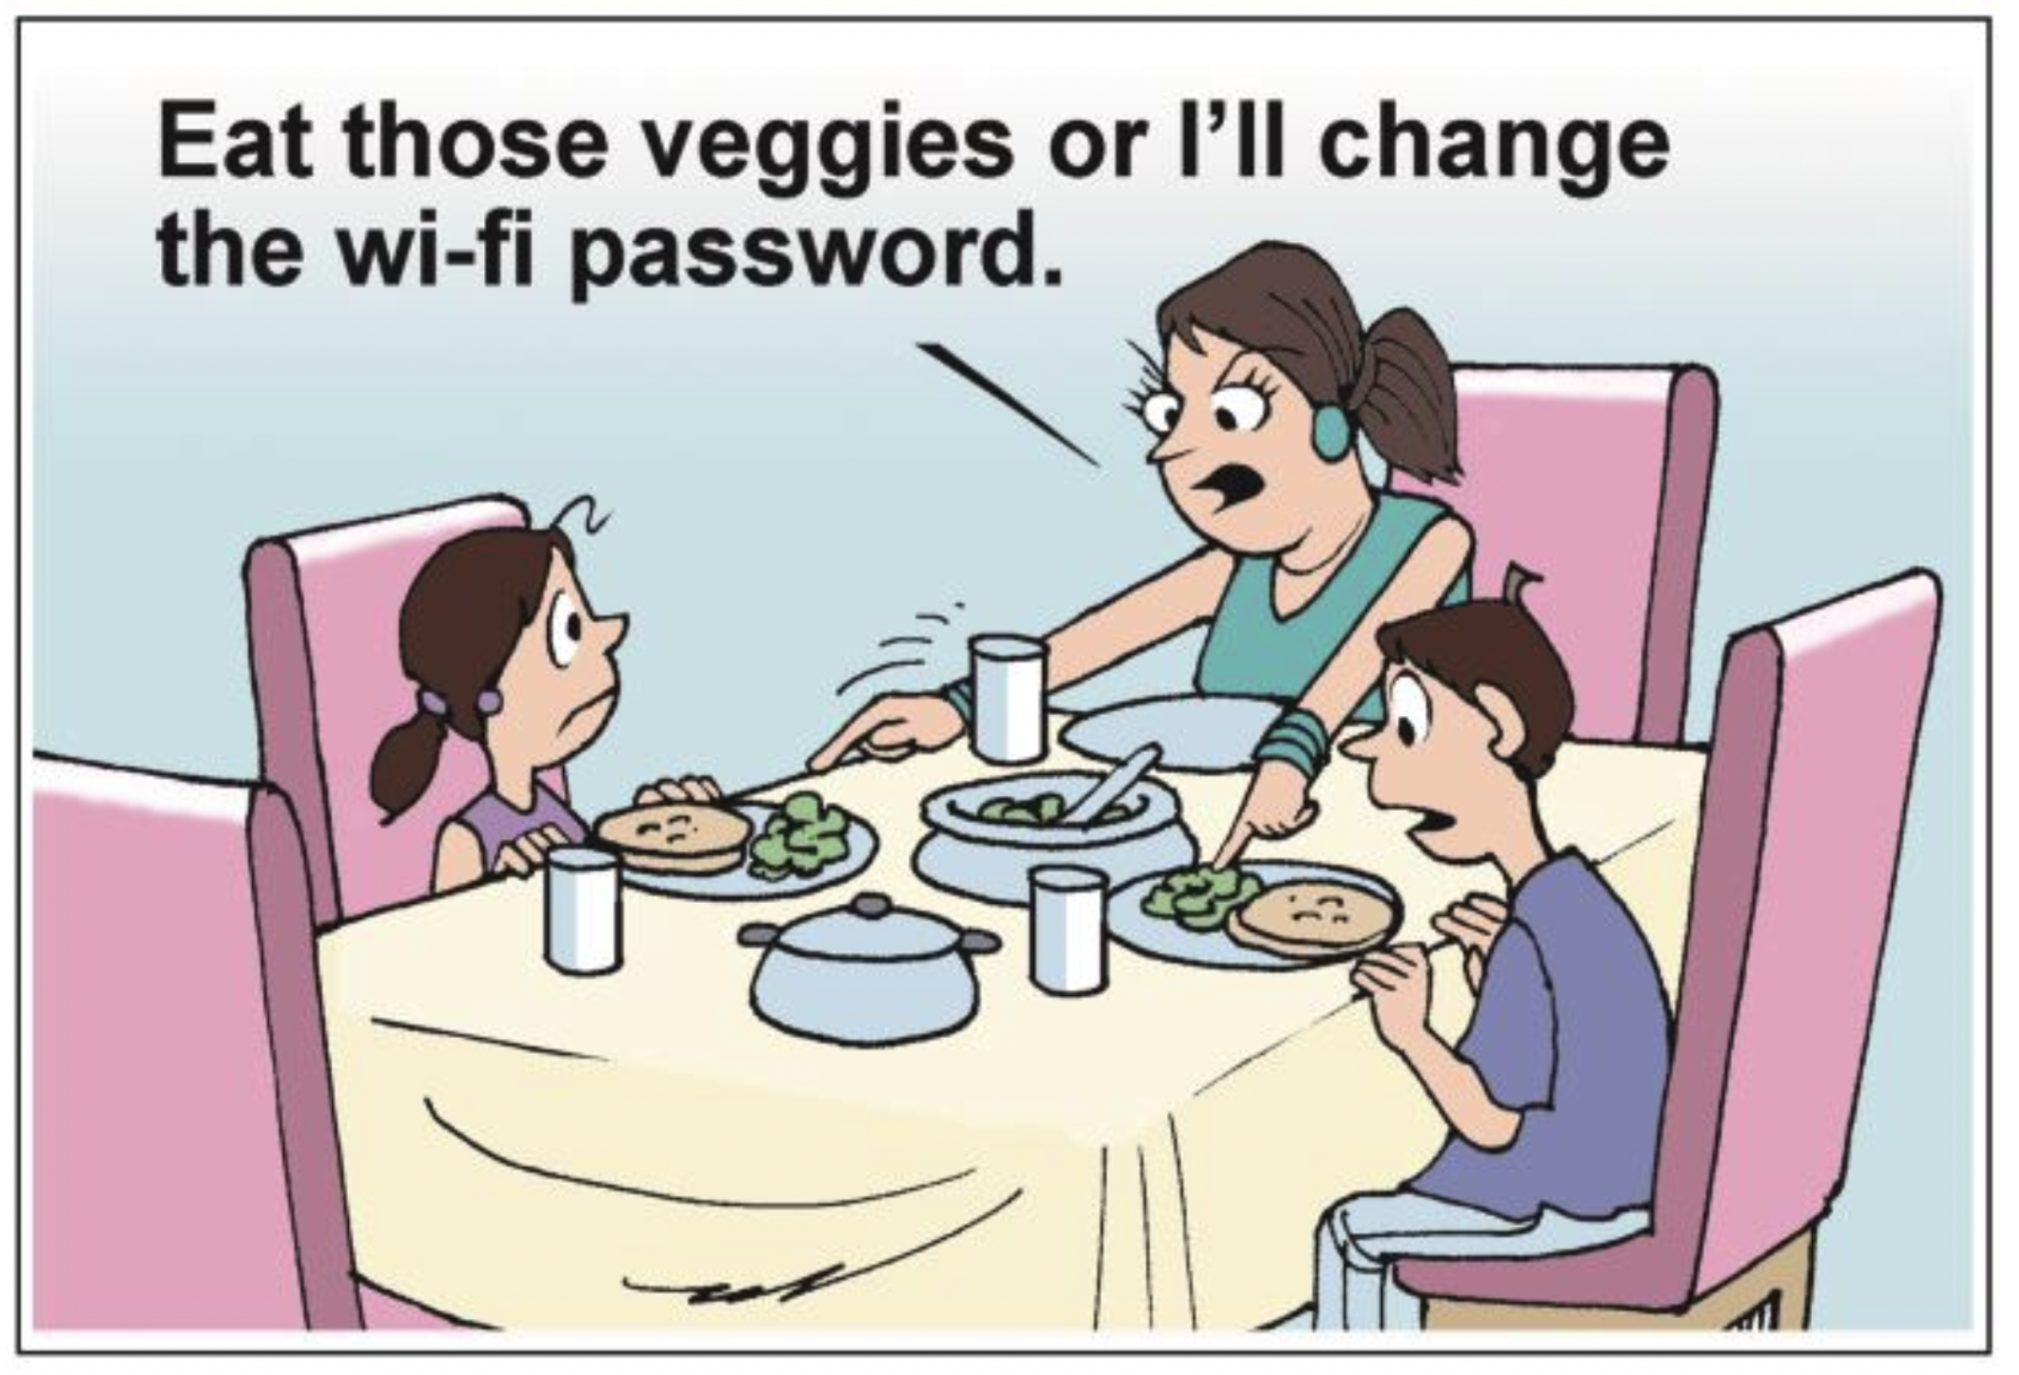
We need your teamwork and insights!
Notes:
Looking forward to ongoing partnerships.

Slide 57
6+++++
Thank you!
Questions?
health.mo.gov
MRO

